Slide 1
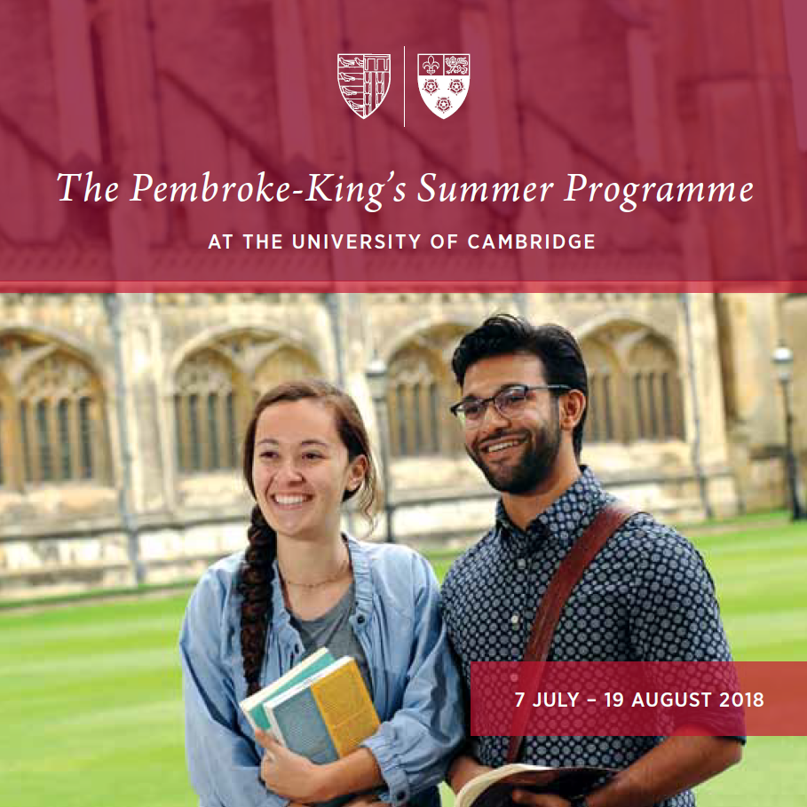

Slide 2


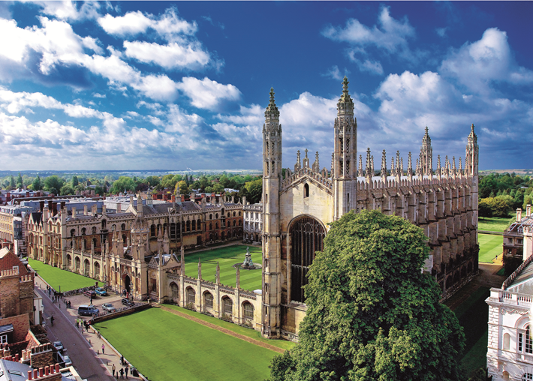
Cambridge
Founded in 1209, Cambridge University is one of the oldest and most prestigious universities in the world
A beautiful city filled with museums, art galleries, theatres and libraries

Slide 3
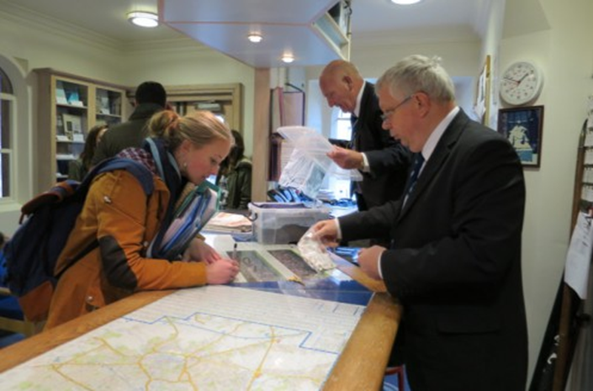
The PKP Experience
What is ‘The PKP Experience?’
  Excellent academic experience
  Exciting social programme
  Fantastic opportunity to experience Cambridge student life
  An unforgettable summer abroad!
Pembroke and King’s Colleges – friendly and supportive communities with outstanding facilities
Study with around 350 students from top universities all over the world: Yale, Harvard, Princeton and others

Slide 4
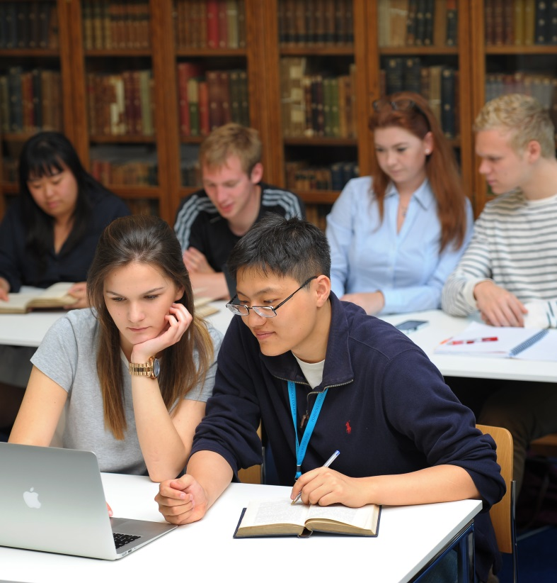
Academic Programme
Unique Features
Cambridge style of teaching:
  Intensive small group teaching
  Out of classroom interaction
  Individual feedback on performance
  Guided independent study
Class sizes capped at 30 students; seminars usually at 15 students allowing for interactive engagement with young enterprising viewpoints from around the world
Independent Supervision option: exceptional opportunity to experience Cambridge-style supervisions

Slide 5
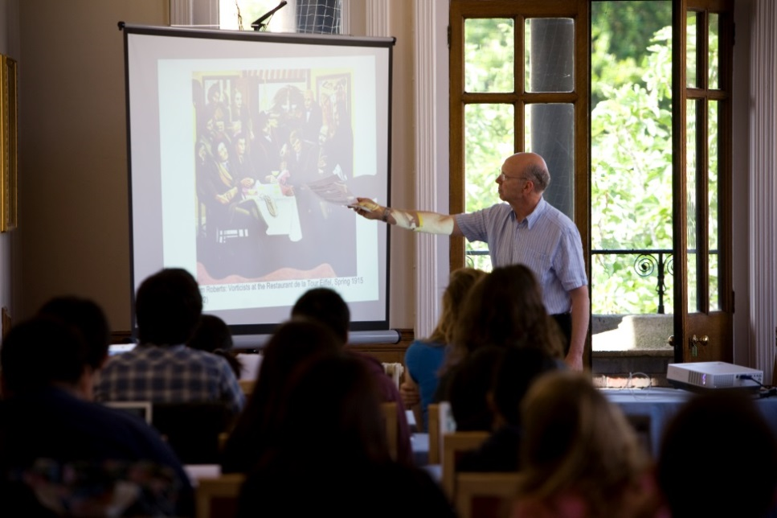
Academic Programme
Courses
Around 45 courses available in: Social Sciences, Science and Maths, Economics, Business and Management, Arts and Humanities
12 Lectures, 8 Seminars per course (25 contact hours)
Students choose three courses (4 credits each); or two courses and one supervision
Assessment: usually take-home exam and final dissertation
Formalised feedback during the course allowing students the opportunity to learn and improve academic performance

Slide 6
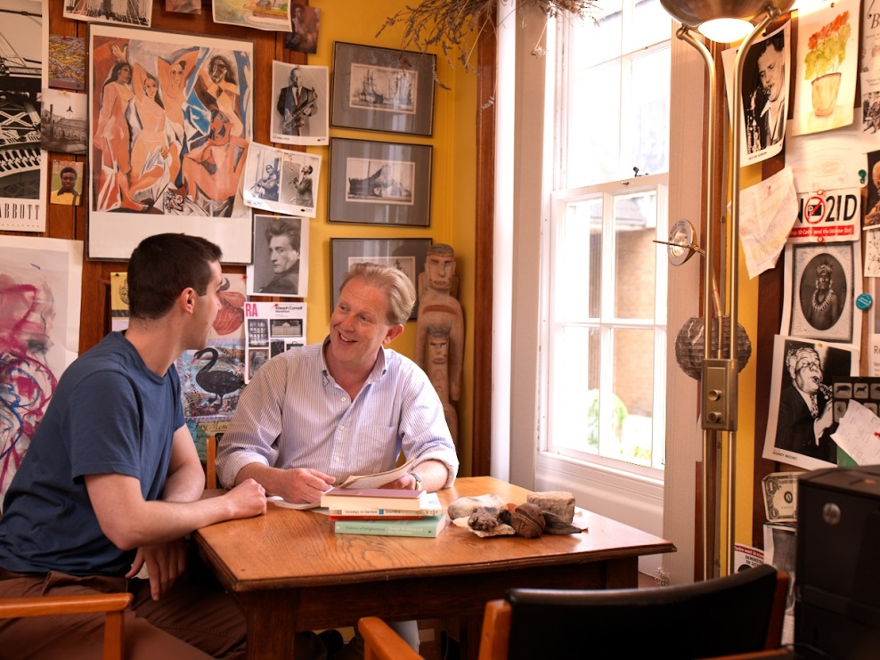
Academic Programme
Independent Supervision (Optional)
Replaces one course
Extraordinary opportunity to work on an independent research project of the student’s own choosing under guidance of a Supervisor (expert in the field)
Students have to submit a proposal: deadline 3 weeks from offer (latest 28th April 2018)

Slide 7
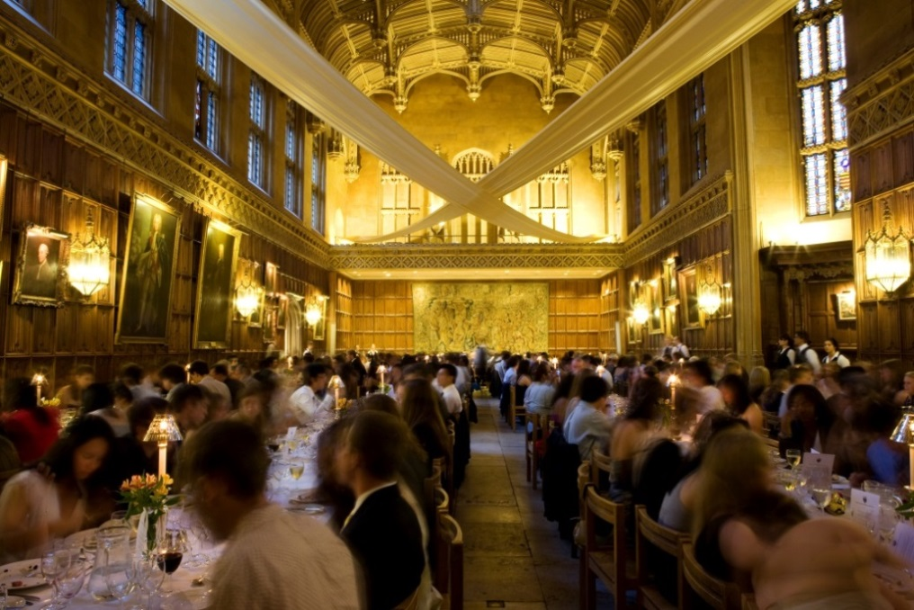
Accommodation and Meals
All students have single occupancy rooms in College accommodation
Meal plan at Pembroke or King’s
Three Formal Halls
  Three-course meals served in historic dining halls

Slide 8
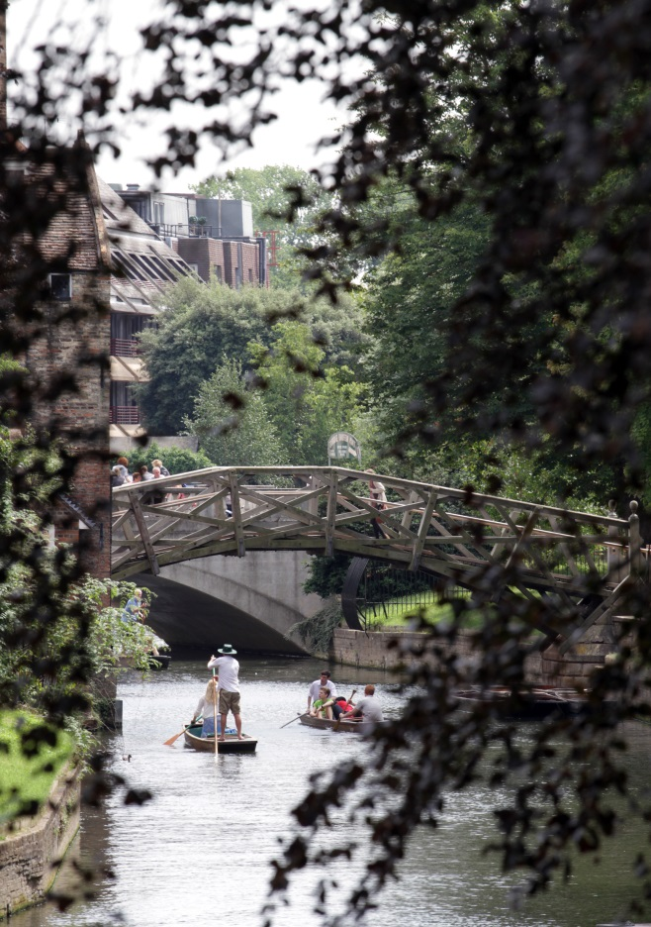
Social Programme
A team of Cambridge Students act as Programme Assistants (PAs) to organise social activities
Social programme:
  Free / Subsidised activities organised throughout the programme. Such as:
    Football / Cricket
    Karaoke nights
    A walk to Wimpole Hall or Grantchester Tea Rooms
    Punting on the river Cam
    And more!

Slide 9
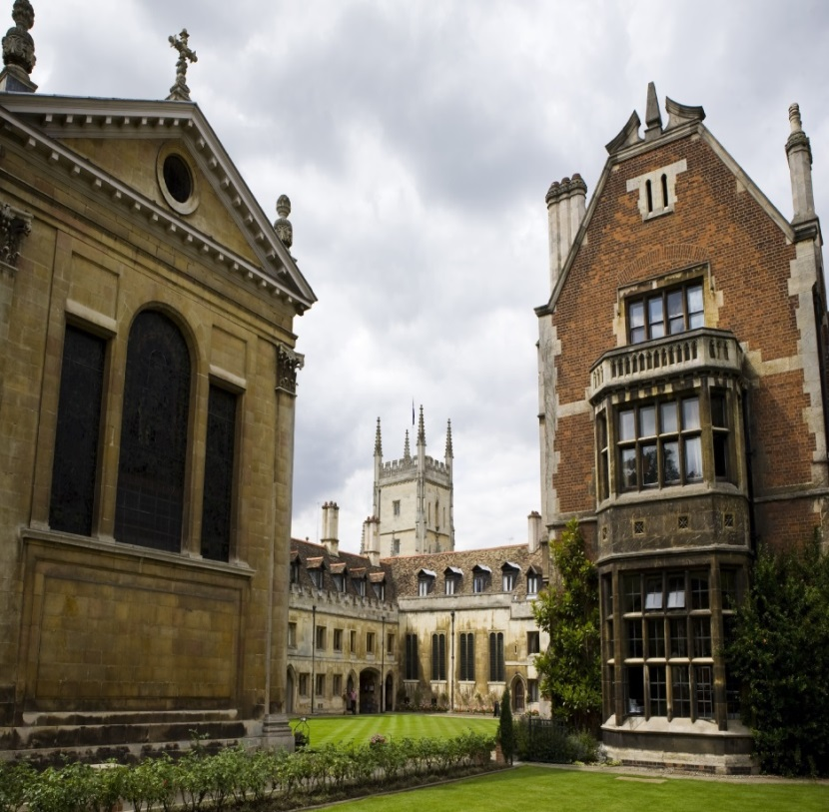
Programme Costs
Application Fee: £60
Tuition Fee: £3,850
  Courses fee
  Study skills sessions (Social Sciences and Sciences)
  Three plenary lectures
Accommodation Fee:
  Between £1,746 - £2,372 depending on accommodation band
  Includes meal plan and social programme
Independent Supervision Supplement: £990 (optional)

Slide 10
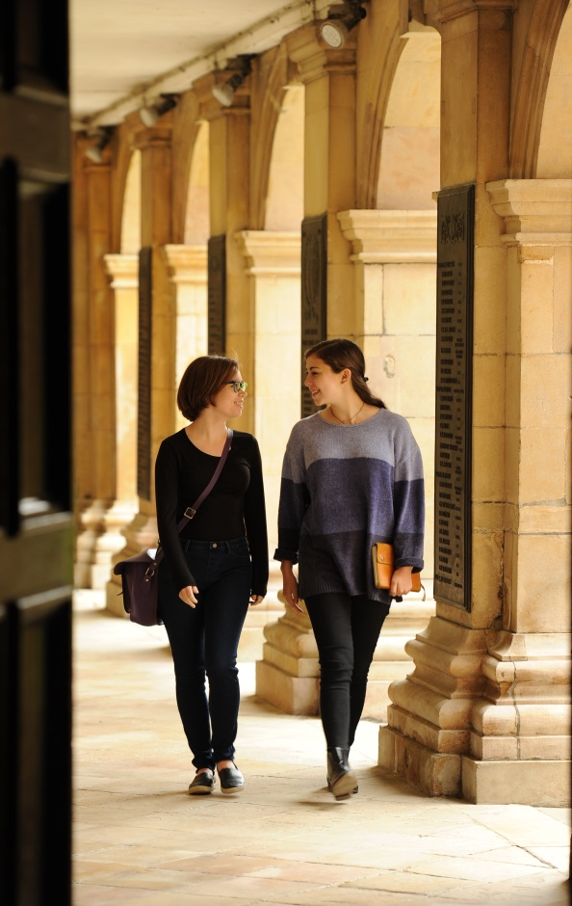
Applications
Online application: open now!
Places fill up fast – early application recommended
Minimum GPA of 3.2
Supporting documents: transcript and academic reference sent directly by home institution or academic referee
Decisions on complete applications conveyed in 5 working days – fast track your applications – conditional offers pending receipt of your academic reference / transcript

Slide 11
Pembroke College Circle
Life-long membership of the Pembroke College Circle (an alumni network)
Network of 3,000 members around the world
Regular communications from Pembroke College, and invitations to special events
Free to join and all PKP students receive a personalised membership card

Slide 12
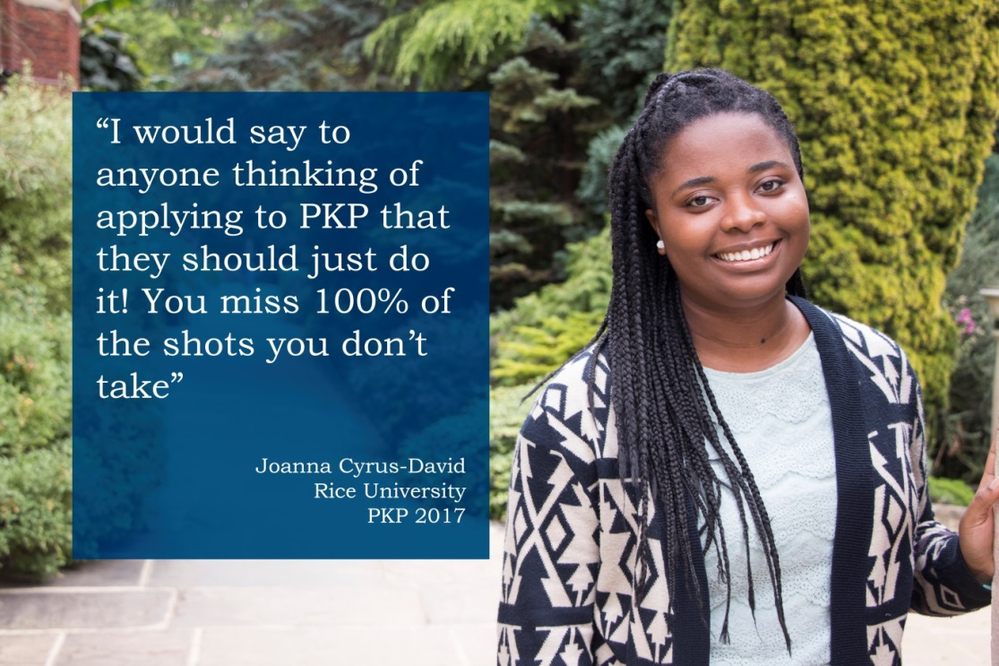


Further Information
www.pem.cam.ac.uk/pkp
Facebook.com/PembrokeKingsProgramme
pkp@pem.cam.ac.uk
@PembrokeIP

